Slide 1
Preparing for GDPR…
Data Protection, Security, Privacy in the Cloud and the projected Legal Impact
David Topping
Please note – because of the copious use of animation this presentation is best viewed as a screen show rather than a series of slides.
If you wish to re-use any elements please contact me at:
David_Topping@dtcom.me.uk
Notes:
Cybersecurity is too important to …

Slide 2
Preparing for GDPR…
Data Protection, Security, Privacy in the Cloud and the projected Legal Impact
GDPR
Notes:
Simon Wilson - Account Director at Darktrace
Jonathan McDonald
Mark Bailey

Slide 3
Perspective
GDPR
Consumer Protection Legislation
Personal Data of Data Subjects
Responsibility as Controller or Processor

Slide 4
Perspective
Accounts Data
Contracts Information
Policy Database
GDPR

Slide 5
GDPR: a point in time
GDPR
Now
May 2018
Data / Supplier / Cloud Audit
Systems Analysis
Policies
Staff Awareness & Training
Implementation

Slide 6
What is the Cloud?
Storage
Outsourced Core Systems
Mail / Exchange / Transport

Slide 7
The Cloud Suppliers
Google / Amazon / Microsoft
Smaller Specialists
The bloke with a connected NAS box

Slide 8

The Cloud Suppliers
The “Cloud” is someone else’s computer, you are still responsible for YOUR data.
A bad business can run on the best Cloud infrastructure.
Due diligence in the Cloud is a business issue not just an IT issue.

Slide 9






Infrastructure Security
www

Slide 10








Infrastructure Security
www

Slide 11





Information Security
Information Security
  Research Results
  Strategic Plans
  Quarterly Results
  New Product Plans
  Personal Data!
www
www

Slide 12

Corporate Security Policy
Information Security Policy Version: 1_06
Document Contents
1 Foreword............................................................................................................................7
2 Policy summary/statement of principles............................................................................8
3 Summary............................................................................................................................9
3.1 Summary of Legal Requirements...............................................................................9
3.2 Purpose and Scope of the Policy.............................................................................10
3.3 Who is affected by the policy....................................................................................10
3.4 Where the policy applies..........................................................................................10
3.5 Security Policy Objectives........................................................................................11
3.6 Review and Audit......................................................................................................11
4 Security Management and Responsibilities.....................................................................12
4.1 Rationale..................................................................................................................12
4.2 Allocation Of Security Responsibilities ....................................................................12
4.3 Service Director: ICT................................................................................................12
4.4 Data Owner...............................................................................................................12
4.5 Management Responsibilities...................................................................................13
4.6 Staff Responsibilities................................................................................................13
4.7 System Managers.....................................................................................................14
5 Security Aspects of Human Resources...........................................................................15
5.1 Personnel Screening and Staff Vetting....................................................................15
5.2 Contractors...............................................................................................................15
5.3 Changes in Employment Status...............................................................................15
6 Information Systems, Acquisition, Development, and Maintenance...............................16
7 Information Classification.................................................................................................18
7.1 Classification Guidance............................................................................................18
7.2 Classification Levels of Protectively Marked Information.........................................18
8 Enabling the flow of information.......................................................................................20
8.1 Regular Sharing of Data / Information with other organisations..............................20
8.2 Ad-Hoc Sharing Data / Information with other organisations..................................20
8.3 Purpose and usage of information systems.............................................................20
8.4 Intruder and Malevolent software protection............................................................21
8.5 Encryption of security marked information...............................................................21
8.6 Email ........................................................................................................................21
8.7 Internet .....................................................................................................................22
8.8 Postal Security..........................................................................................................22
8.9 Telephone Security...................................................................................................22
8.10 Fax Security............................................................................................................22
8.11 Verbal Communications.........................................................................................22
9 Risk management............................................................................................................23
9.1 Background...............................................................................................................23
9.2 Types of Risk............................................................................................................23
9.3 Risk Assessment......................................................................................................23
9.4 Security Incidents ....................................................................................................23
10 Business Continuity.......................................................................................................24
10.1 Need for effective plans..........................................................................................24
11 Control of Access and Assets........................................................................................26
11.1 Equipment and Software Registers (Asset Control)...............................................26
11.2 Access Control to Secure Areas.............................................................................26
11.3 Security of Third Party Access ..............................................................................27
11.4 User Access Controls.............................................................................................27
Information Security Policy Version 1_06a.doc 5 12/12/12
Information Security Policy Version: 1_06
11.5 Visitors and Contractors.........................................................................................29
11.6 Housekeeping.........................................................................................................29
11.7 Software and Information Protection......................................................................30
11.8 Equipment Security.................................................................................................31
11.9 Power Supplies.......................................................................................................31
11.10 Network Security...................................................................................................32
11.11 Use of Modems and other communications equipment.......................................32
11.12 Mobile, Portable and Hand-held computing equipment.......................................32
12 Information Security Incident Management...................................................................34
12.1 Security Incident Definition.....................................................................................34
12.2 Security Incident categorisation..............................................................................34
12.3 What is monitored under this policy.......................................................................34
12.4 Actions to take on the discovery of an incident......................................................34
12.5 Lines of Internal Reporting.....................................................................................34
12.6 Lines of external reporting......................................................................................34
12.7 Handling a reported security incident.....................................................................35
12.8 Investigation and Reporting lines for incidents.......................................................35
13 Physical Security of Information....................................................................................37
13.1 Security within Bristol City Council Offices.............................................................37
13.2 Security Outside Bristol City Council Offices..........................................................37
13.3 Transportation.........................................................................................................37
13.4 Responsibility..........................................................................................................37
13.5 Disposal..................................................................................................................37
14 Using BCC IT Equipment outside of the UK..................................................................39
15 Home, flexible, and mobile, working Information Security Standards...........................40
15.1 Smart Working Policy.............................................................................................40
15.2 Authorisation to Remove Data Files.......................................................................40
15.3 The Transfer of personal data files.........................................................................40
15.4 Protecting data files................................................................................................40
15.5 Use of privately owned IT equipment when at home ............................................40
15.6 Transportation of data or confidential documents..................................................40
15.7 Storage of Equipment.............................................................................................40
15.8 Storage of confidential data or reports...................................................................41
16 Compliance And Legal Requirements...........................................................................42
16.1 Legislative Acts relating to Information Security....................................................42
16.2 Non-Legislative Acts...............................................................................................43
16.3 Security Policy, Standards and Technical Compliance..........................................44
17 Audit of Information Systems.........................................................................................45
17.1 Audit Planning.........................................................................................................45
17.2 Protection of Audit tools .........................................................................................45
17.3 Systems Monitoring................................................................................................45
18 Glossary and Abbreviations...........................................................................................46
19 Associated Policies, Procedures, Standards, and Guidance Notes.............................49
7.2 Classification Levels of Protectively Marked Information
7.2.1 Level 0 - Unclassified Information
This level of classification relates to information that has no current local, national or
legal restrictions on access or usage.
7.2.2 Level 1 - Due Care
Information that is not intended for public use or disclosure, but where disclosure
would not materially impact the Council in terms of financial loss, service delivery
failure, loss of reputation or embarrassment.
7.2.3 Level 2 - Protected Information
Information that if made public, or even shared within the Council, could cause
harm to the Council, its customers and partners. It is information that needs to be
secured for legal proprietary, ethical or privacy reasons and access restricted to
users who have a legitimate business need to see it.
7.2.4 Level 3 - Restricted Information
The compromise of this information or material would be likely: to affect diplomatic
relations adversely; to cause substantial distress to individuals; to make it more
difficult to maintain the operational effectiveness or security of UK or allied forces; to
cause financial loss or loss of earning potential to or facilitate improper gain or
advantage for individuals or companies; to prejudice the investigation or facilitate
the commission of crime; to breach proper undertakings to maintain the confidence
of information provided by third parties; to impede the effective development or
operation of government policies; to breach statutory restrictions on disclosure of
information; to disadvantage Government in commercial or policy negotiations with
others; to undermine the proper management of the public sector and its
operations.
7.2.5 Level 4 - Confidential Information
The compromise of this information or material would be likely: materially to
damage diplomatic relations (i.e. cause formal protest or other sanction); to
prejudice individual security or liberty; to cause damage to the operational
effectiveness or security of UK or allied forces or the effectiveness of valuable
security or intelligence operations; to work substantially against national finances or
economic and commercial interests; substantially to undermine the financial viability
of major organisations; to impede the investigation or facilitate the commission of
serious crime; to impede seriously the development or operation of major
government policies; to shut down or otherwise substantially disrupt significant
national operations.
7.2.6 Level 5 - Secret Information
The compromise of this information or material would be likely: to raise international
tension; to damage seriously relations with friendly Governments; to threaten life
directly, or seriously prejudice public order, or individual security or liberty; to cause
serious damage to the operational effectiveness or security of UK or allied forces or
the continuing effectiveness of highly valuable security or intelligence operations; to
cause substantial material damage to national finances or economic and
commercial interests.
7.2.7 Level 6 - Top Secret
The compromise of this information or material would be likely: to threaten directly
the internal stability of the UK or friendly countries; to lead directly to widespread
loss of life; to cause exceptionally grave damage to the effectiveness or security of
UK or allied forces or to the continuing effectiveness of extremely valuable security
or intelligence operations; to cause exceptionally grave damage to relations with
friendly Governments; to cause severe long-term damage to the UK economy.
Information
Information Security Policy Version: 1_06
15 Home, flexible, and mobile, working Information Security
Standards
15.1 Smart Working Policy
Authorisation to work flexibly (home or mobile working etc) is covered by the Smart
Working HR Policy.
In all matters of information security, this policy (the Information Security Policy) has
precedence.
15.2 Authorisation to Remove Data Files
Formal written authorisation by your line manager is required before any
identifiable data files can be taken home. Each line manager must inform the head
of ICT of all staff who regularly work with information at home.
15.3 The Transfer of personal data files
Data files that identify individuals, must not be sent via email to a user’s home mail
box. Internet mail is not secure and should not be used to transmit confidential
information.
15.4 Protecting data files
All electronic files used at home must be protected at least by file level password
control. All sensitive information must be encrypted
15.5 Use of privately owned IT equipment when at home
General Internet access carries with it a security risk of downloading viruses or
programs that can look around a network and infiltrate password security systems.
This information can then be sent back to the originator of the program in order to
allow them unauthorised access to our systems. Therefore you must use care when
transferring data between your home PC and Bristol City Council network. All home
PCs which are used for the manipulation of Bristol City Council data must have a
current virus checker.
15.6 Transportation of data or confidential documents
You should take reasonable care to minimise the risk of theft or damage, IT
equipment must be transported in a clean, secure environment. During transfer of
equipment between home and work you should keep the equipment out of sight and
not leave it unattended at any time.
15.7 Storage of Equipment
You should take all reasonable steps to minimise the visibility of computer
15.8 Storage of confidential data or reports
You should secure confidential data or reports that you are not actively using in the
most secure area of your home.
… Page 49
  Research Results
  Strategic Plans
  Quarterly Results
  New Product Plans
  Personal Data!
www

Slide 13
Information Security – KISS
Decision Making:
  Am I sure it‘s Sensitive?
  Am I sure it‘s not Sensitive?
  Could it be Sensitive?
www

Slide 14
Information Security – KISS
High Sensitivity
Decision Making:
  Am I sure it‘s Sensitive?
  Am I sure it‘s not Sensitive?
  Could it be Sensitive?
  Am I sure it‘s Sensitive?
I know it’s Sensitive
Medium Sensitivity
Administrator
  Am I sure it‘s not Sensitive?
  Could it be Sensitive?
Low Sensitivity
Behaviour Defined
45 second overview of BS 10010 “Information Classification, Marking and Handling”
www
Creator
I’m not sure if it’s Sensitive
Partner
Definitively Marked
I know it’s not Sensitive
No Marking

Slide 15
Information Security
Organisation Policy:
  Provide simple categories
  Define which categories can be sent to which recipients
  Manage the process
  Control the interaction
Foundation for any Data Loss Prevention scheme or system
www
www

Slide 16
Information Security – Technology
www

Slide 17
Information Security – Technology
www

Slide 18
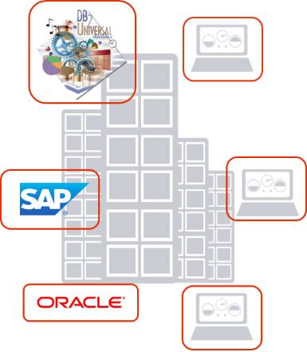
Information Security – Technology
www
VPN

Slide 19
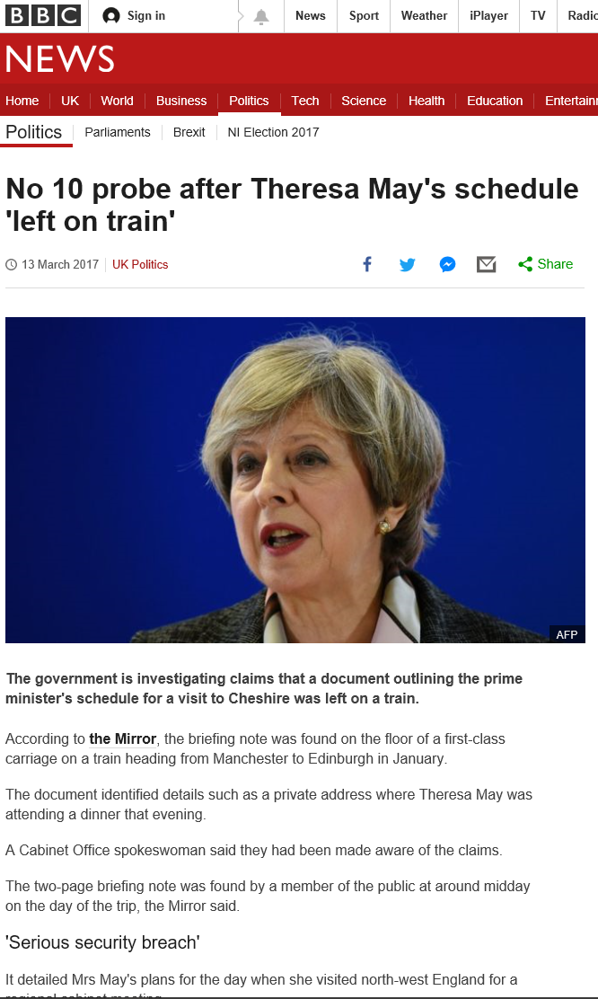
Information Security – Not just technology
Confidential Document
Schedule
TM
11:00 Arrive St. Albans
11:30 Leave HQ
12:00 Lunch at Freemans Arms
14:00 Meetings at local HQ
19:00 Dinner
22:30 Staying at
The Farmhouse
Lower Blagdon under Marsh
Oxfordshire OX11 9BG
Schedule
Theresa May
Prime Minister
11:00 Arrive St. Albans
11:30 Leave HQ
12:00 Lunch at Freemans Arms
14:00 Meetings at local HQ
19:00 Dinner
22:30 Staying at
The Farmhouse
Lower Blagdon under Marsh
Oxfordshire OX11 9BG

Slide 20
Information Security – Common Sense
My mix disc
+ other stuff
Confidential details of 25Million Benefits recipients
HMRC
Confidential

Slide 21
Information Security – Cyberattacks!!!!!!!!! …. Eh?
Compare:
“We suffered a major Cyberattack!”
To:
“Some idiot clicked on a porn site and killed our business.”

Slide 22
Mit der Dummheit kämpfen Götter selbst vergebens
Against stupidity the Gods themselves contend in vain
Friedrich Schiller
Maid of Orléans
1801
… but we can fix ignorance in an afternoon!

Slide 23
Preparing for GDPR – Summary
GDPR is important –
BUT It is only PART of your overall effort in “Cybersecurity”
It is a point in time for you to aim at
Getting it wrong can be incredibly damaging and costly
Choose your Cloud system based on your information, data and operations:
It is not your system – it IS your data
Due diligence is a business process
Not all Cloud suppliers are reliable, even if they run on Amazon / Google / Azure
Data Security is also about Information Security:
It is as much about people as it is about systems
You can’t guard what you don’t understand
Build processes that are simple to operate!
  Good security is simple security

Slide 24
Preparing for GDPR…
Data Protection, Security, Privacy in the Cloud and the projected Legal Impact
David Topping

